Slide 1
Moxie Devices
The Green Initiative

Slide 2
About US
Specialized in designing and manufacturing of electronic Circuits/Drivers/PCBs that drives various applications
Established Q1 2012
PRODUCT line includes:
Solar Lantern
Solar mobile chargers
LED indoor lights
Solar Street lights
Technical Consultancy Services

Slide 3
Why Moxie?
Our team comes with approx 40 man-years of diverse experience in semiconductor Industry on cutting edge technologies.
One stop shop for all types of LED and Solar products having tie ups with channel partners
Innovative and energy efficient solution provider

Slide 4
Roadmap
32 bit Micro-controller
based drivers
Solar Lantern
Invertors
Street Lights
MNRE Solar LED
Lantern
LED Indoor lighting
Solar Mobile
Charger
Commercial Solar
Lantern
R&D
Oct 2012
Nov 2012
Dec 2012
Jan 2013
Feb 2013
Mar 2013
Apr - Sep 2012

Slide 5
MSLD6D Solar Lantern LED Driver and Battery Charger
Product Features
High efficiency > 85%
PWM Dimming
Battery reverse discharging protection
LED charging indicator
Battery over voltage protection
Best suited for commercial 6V SMF solar charged lanterns
Solder free design
Low cost
Application
MSLD6D is a high efficiency LED driver with SMF battery charging for 6V SMF and efficient PWM Dimming control. It houses state of art protection circuits for Battery reverse charging, over voltage protection.
This is best suited for designing of Solar Lanterns, powered with 6V SMF battery. It can drive LED string with output power 1.5W to 2.4W

Slide 6
MSLD12M - MNRE Specification Solar Lantern LED Driver and Battery Charger
Product Features
High efficiency > 85%
Regulated Voltage, Constant Current LED driver
Reverse flow protection
No load protection
Low voltage(11.4V)/over charge(14 V) cutoff
Battery reverse polarity protection
Best suited for commercial 12V SMF solar charged lanterns
Solder free design
Low cost
Application
MSLD6D is a high efficiency LED driver with SMF battery charging for 12V SMF. It is compliant to MNRE specifications for protection circuit requirements & indicators requirement.
This is best suited for designing of Solar Lanterns, powered with 12V SMF battery.

Slide 7
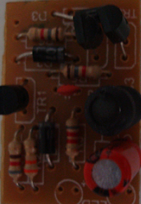
MMC6 - Mobile Charger for 6V Battery
Product Features
Highly efficient constant current driver
Regulated voltage
Low power dissipation
Low heat dissipation
Wide range ambient temperature
Best suited for mobile chargers working with 6 V battery
Low cost/low component count
Application
MMC6 is a high efficiency mobile battery charger operating at input DC voltage of 6V.
This is best suited for integration in 6V DC battery operated designs like Solar Lanterns.

Slide 8
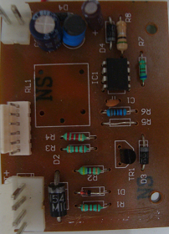
MMC12 - Mobile Charger for 12V Battery
Product Features
IC regulated, highly efficient constant current driver
Regulated voltage
Low power dissipation
Low heat dissipation
Wide range ambient temperature
Best suited for mobile chargers working with 12 V battery
Low cost/low component count
Application
MMC12 is a high efficiency mobile battery charger operating at input DC voltage of 12V.
This is best suited for integration in 12V DC battery operated designs like Solar Lanterns.

Slide 9

Corporate Office:
Moxie Devices Pvt Ltd
G-212, Sector 63, Noida 201301
Phone: 8860497497 8860498498
Email: contact@moxiedevices.com
Website: www.moxiedevices.com

